Slide 1
Queues
Lesson 4

Slide 2

Queue
A restricted access container that stores a linear collection
Very common for solving problems in Computer Science that requires data to be processed in the order in which it was received
Provides a first-in first-out (FIFO) protocol
New items are added at the back while existing items are removed from the front of the queue

Slide 3
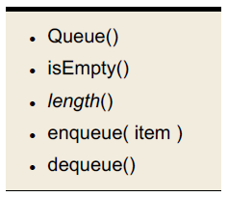
The Queue ADT
A queue stores a linear collection of items with access limited to a first-in first-out order.
New items are added to the stack
Existing items are removed from the front

Slide 4
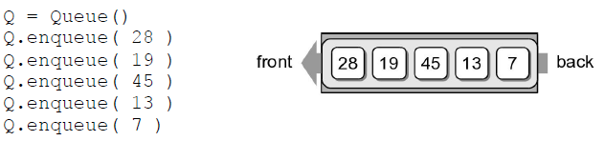
Queue Example
The following code creates the queue from earlier.

Slide 5
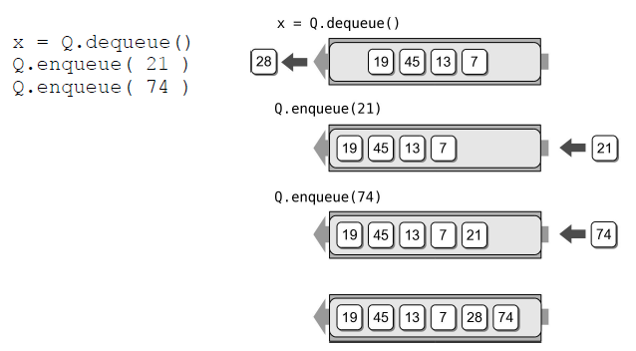
Queue Example
We can remove items from the queue and add more items.

Slide 6
Queue implementation
Several common ways to implement a queue:
Python list
Easiest to implement
Circular array
Fast operations with a fixed size queue
Linked list
Reduces memory wastes by eliminating the extra capacity created with a vector

Slide 7
Queue: Python list
q1 = Queue()
q1.enqueue(2)
q1.enqueue(4)
q1.enqueue(6)
q1.enqueue(8)
Implementation 1
Implementation 2
2 | 4 | 6 | 8
8 | 6 | 4 | 2
enqueue(10) Add new items to the end of the list append O(1)
enqueue(10)
Add new items to the front of the list insert(0, item) O(n)
2 | 4 | 6 | 8 | 10
10 | 8 | 6 | 4 | 2
dequeue()
Remove items from the front of the list pop(0) O(n)
dequeue()
Remove items from the back of the list pop() O(1)
4 | 6 | 8 | 10
8 | 6 | 4 | 2

Slide 8
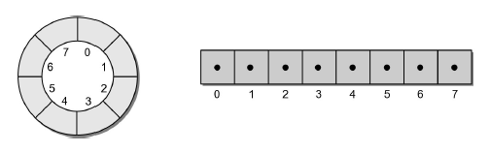
Queue: Circular Array
Circular array – an array viewed as a circle instead of a line.
Items can be added/removed without having to shift the remaining items in the process
Introduces the concept of a maximum-capacity queue that can become full

Slide 9
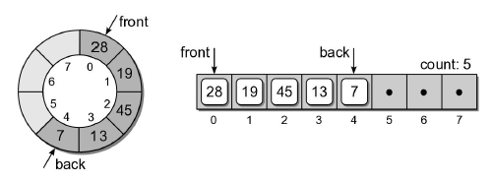
Queue: Circular Array
How should the data be organized within the array
count field – number of items in the queue
Front and back markers – indicate the array elements containing the queue items

Slide 10
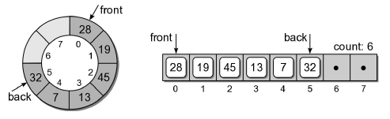
Queue: Circular Array
To enqueue an item:
new item is inserted at the position following back
back is advanced by one position
count is incremented by one
Supposed we enqueue 32:

Slide 11
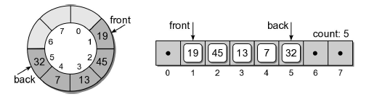
Queue: Circular Array
To dequeue an item:
the value in the front position is saved
front is advanced by one position
count is decremented by one position
Suppose we dequeue an item:

Slide 12
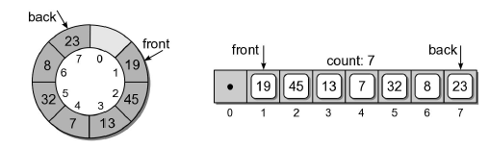
Queue: Circular Array
Suppose we enqueue items 8 and 23:

Slide 13
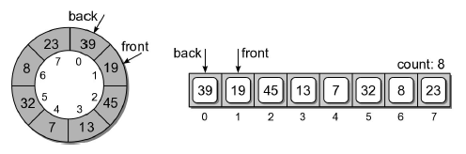
Queue: Circular Array
What happens if we enqueue 39?
Since we are using a circular array, the same steps are followed.
But since back is at the end of the array, it wraps around to the front.

Slide 14
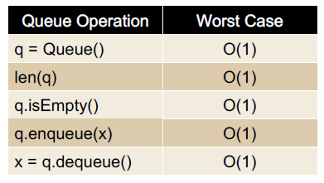
Queue Analysis: Circular Array

Slide 15
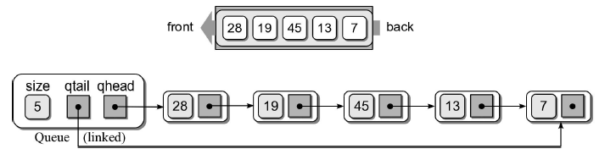
Queue: Linked List
How should the data be organized?
Use both head and tail references
Let the head of the list represent the front of the queue and the tail the back

Slide 16
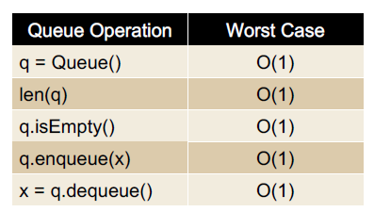
Queue Analysis: Linked List

Slide 17
Priority Queues
Some applications require the use of a queue in which items are assigned a priority
Higher priority items are dequeued first
Items with equal priority still follow FIFO
Two types
bounded – limited range of priorities
Unbounded – unlimited range

Slide 18
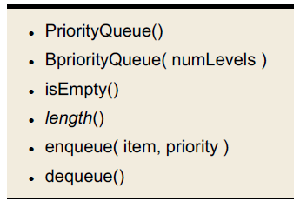
The Priority Queue ADT
A priority queue is a queue in which each item is assigned a priority and items with a higher priority are removed before those with lower priority.
Integer values are used for the priorities
Smaller integers have a higher priority

Slide 19
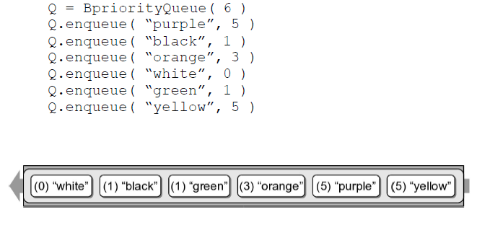
Priority Queue Example
Consider the following code segment:

Slide 20
Priority Queue Implementation
How should the ADT be implemented. We must consider:
A priority must be associated with each item in the queue
The next item dequeued is the item with the highest priority.
If multiple items have the same priority, those must be dequeued in a FIFO order

Slide 21
Unbounded Priority Queue
We explore two approaches
Python list
Linked list

Slide 22
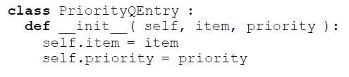
Unbounded Priority Q: Python List
We can use a Python list to implement the unbounded Priority Queue ADT
How do we associate a priority with each item?
How should the entries be organized?
Append new items to the end, or
Keep the items in sorted order based on priority.

Slide 23
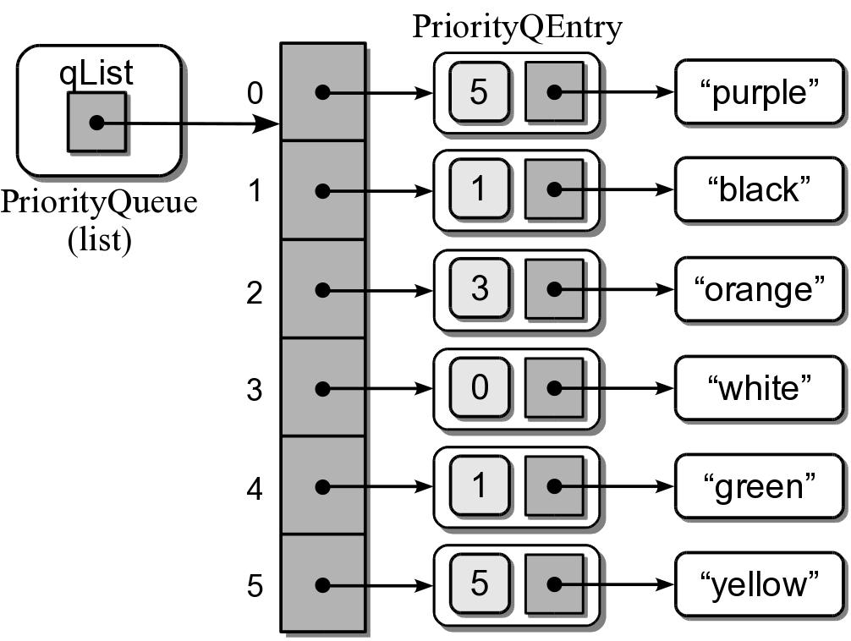
Unbounded Priority Q: Python List
Sample instance for the earlier priority queue.

Slide 24
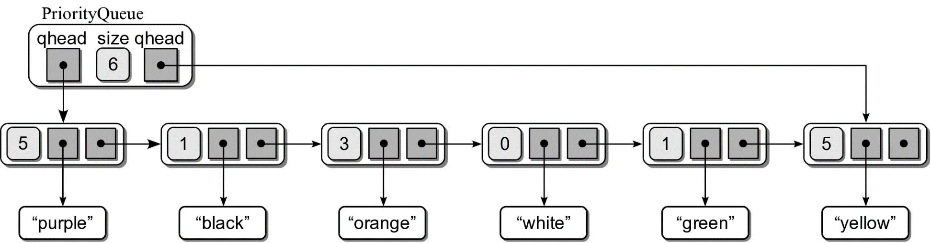
Unbounded Priority Q: Python List
We can use a singly linked list:
Head and tail references
Append new entries to the end

Slide 25
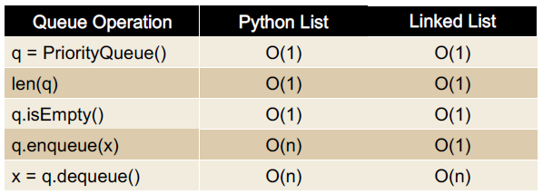
Priority Queue Analysis
The worst case analysis for the two implementation

Slide 26
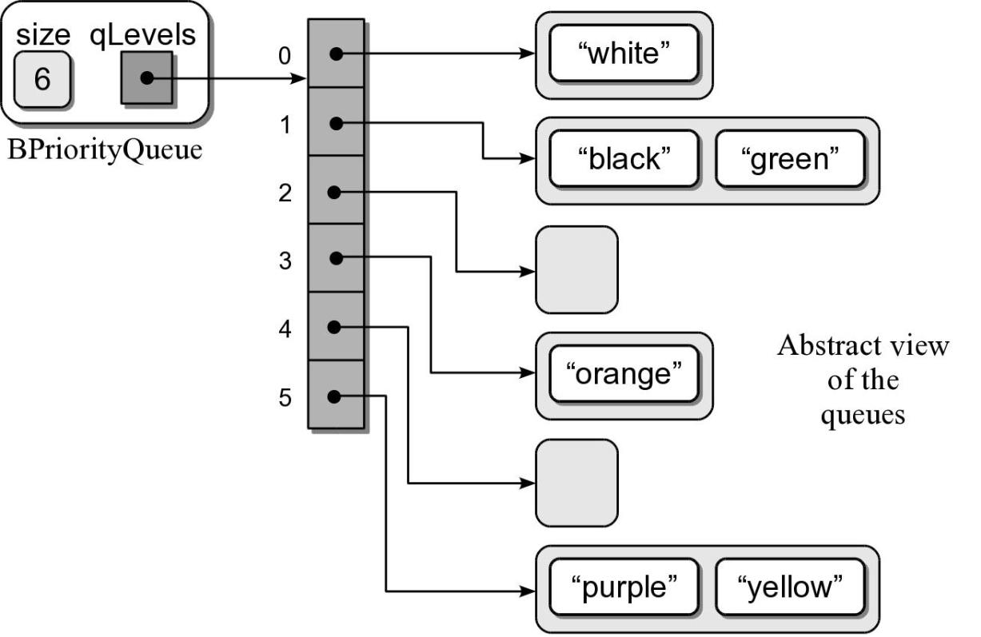
Bounded Priority Queue
We can use the Python list or linked list to implement the bounded Priority Queue
Both require linear time to dequeue an item
We can improve this time using an array of queues

